Slide 1

Yes We CAN!
Cymotive project
By Shilo Babila

Slide 2

Introduction:
Who Cymotive Are?
The Mission Was Given
Report And The Ways Of Investigation
Conclusion
Further investigation

Slide 3

Who Cymotive Are?
CYMOTIVE provide OEMs and Tier-1s with Cyber Security Engineering Lifecycle Services and cutting-edge in-vehicle, backend, mobile services, and other security products.
CYMOTIVE works with there clients during the entire lifecycle phases to ensure security is embedded into their products.
Selected by the world’s #1 automotive group, this unique Purple approach has proven itself as the most effective in dealing with Cyber Security risks, threat detection and response.

Slide 4

The Mission Was Given:
Find anomaly in the log from the client that could be suspicious. Analyze it and check if there any security problems.

Slide 5
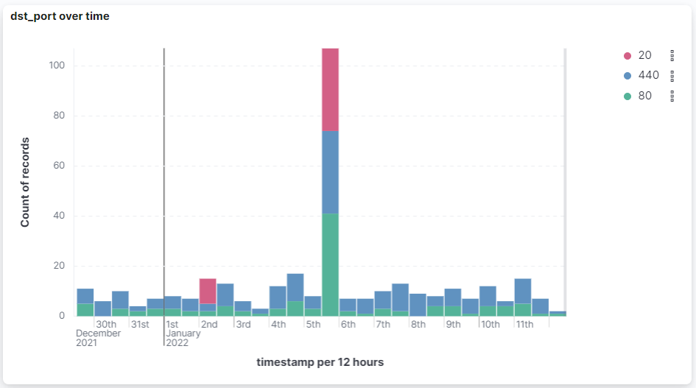
The Investigation:
Checking records over time, divided by ports.
Sew two days (2nd and 5th) with records from port 22.
The 5th has over 100 records

Slide 6
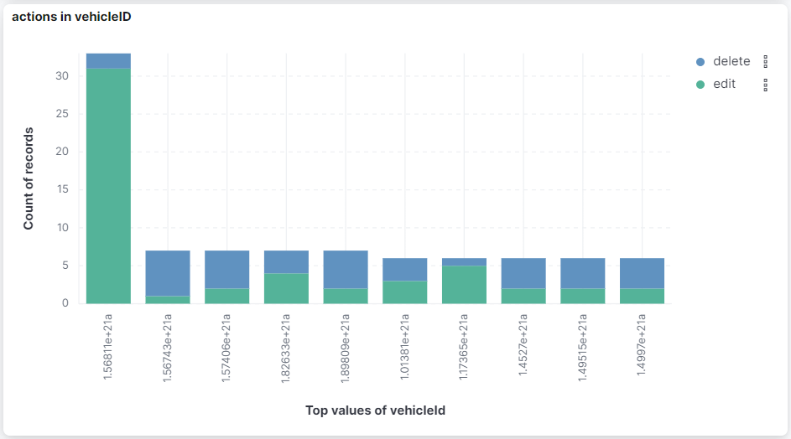
Checking Vehicles:
After knowing there some days with anomaly behavior, the next thing to do if there some vehicle that have anomaly records too.
The graph filtered, so only the delete and edit actions will shown (dangerous actions).
As result the vehicle 1.56811e+21 have higher records from the others.

Slide 7
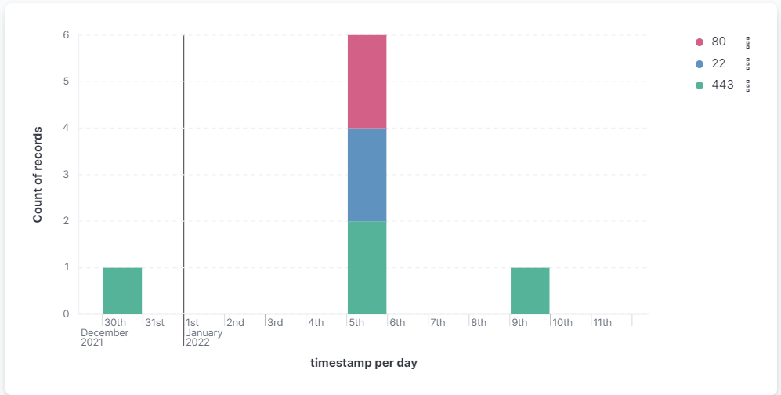
Checking Vehicles In TimeLine:
The TimeLine filtered by the suspicious vehicle (1.56811e+21).
Also filtered by upcoming records, as we want to know if there any attack.
As result, the vehicle has anomaly records from the 5th.

Slide 8
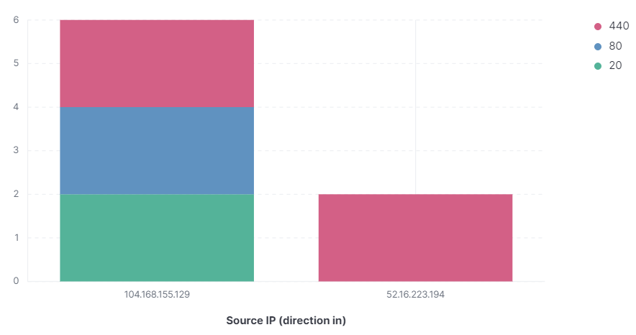
Find who is the hacker:
Filtered all the records from the Jan 5th and sew only two IPs was in used.
One of them (104.168.155.129) also have records with unsecure ports (22 and 80).

Slide 9
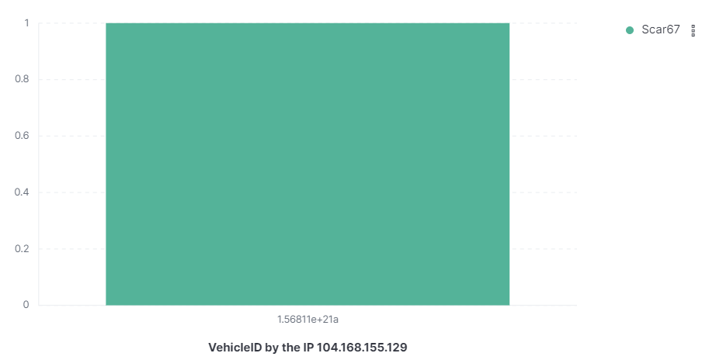
Find who is the hacker:
The suspicious IP filtered to know if there any more vehicle that have records from this IP.
As result only one vehicle has records from this address.
The attack’s user is Scar67. (with the IP 104.168.155.129)

Slide 10
What the hacker did?
All the file’s changes from Jan 5th :
At first, the SSL has changed, what allow for the hacker to do stuff.
After that, he edited the file that control the brake's pressure.
He's next step is to edit the pm_async file what can cause to more brake's orders.
Finally, namespace.conf deleted to blurring traces.
action | filePath | @timestamp | vehicleId
delete | /etc/security/namespace.conf | Jan 5, 2022 @ 22:03:53.078 | 1.56811e+21a
edit | /sys/power/pm_async | Jan 5, 2022 @ 18:10:22.201 | 1.56811e+21a
edit | /sys/module/vmpressure | Jan 5, 2022 @ 10:57:53.955 | 1.56811e+21a
edit | /etc/ssl/certs | Jan 5, 2022 @ 09:41:52.167 | 1.56811e+21a

Slide 11
First Look At The CAN’s TRACE:
On timestamp 20.145305 – the airbag starts to open, Apparently, it was at the time of the accident.
At a certain time, the vehicle increased speed although the brakes was activated.
At a certain time, the steering wheel change his direction frequently from side to side.

Slide 12
Deep info From The CAN’s TRACE:
Almost in all types of 'Massage', the 'B2' value is numbered in order (the common one is from 1 to 0f).
At 16.907469 we start to see anomaly, and numbers 4 and 7 have duplicate, and so on.
1-2 seconds after the duplicate, the steering wheel has change Drastically.
row | TimeStamp | Massage | B1 | B2 | B3 | B4 | B5 | B6 | B7 | B8 | brake actived?
7278 | 16.868002 | msg3 | a0 | 2 | 7 | 2 | 0 | 3 | 14 | 64 | Pressure Brake: 3
7286 | 16.887467 | msg3 | 86 | 3 | 7 | 2 | 0 | 8 | 14 | 64 | Pressure Brake: 8
7295 | 16.907468 | msg3 | 8a | 4 | 27 | 2 | 0 | 0d | 14 | 64 | Pressure Brake: 13
7303 | 16.907469 | msg3 | 8a | 4 | 27 | 2 | 0 | 1 | 14 | 64 | No brake
7304 | 16.92761 | msg3 | 90 | 5 | 27 | 2 | 0 | 14 | 1b | 64 | Pressure Brake: 14
7314 | 16.947778 | msg3 | ee | 6 | 27 | 2 | 0 | 1a | 1d | 64 | Pressure Brake: 26
7321 | 16.967635 | msg3 | 6c | 7 | 27 | 2 | 0 | 1 | 22 | 64 | No brake
7322 | 16.967635 | msg3 | 6c | 7 | 27 | 2 | 0 | 21 | 22 | 64 | Pressure Brake: 21

Slide 13
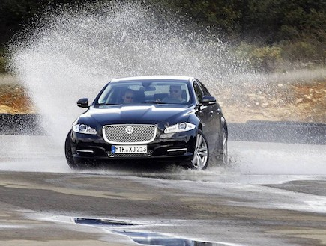
Conclusion:
The brakes are not active enough pressure (cause the edit of file), The vehicle continued to travel (and even increased speed), the driver sew he can't slow with the brakes, so he tried to slow down by moving the vehicle from side to side.
The brakes are activated remotely (by the hacker) and its cause to the vehicle to slip on the road, so the driver tried to stable it using the steering wheel.
The second option is making more sense, as the brakes works by mechanics. but this can be different in each vehicle.

Slide 14

Further investigation:
Check strange behavior from:
The users Shreder32 and Guest_1
The vehicles: 1.57725e+21, 1.94329e+21, 1.61764e+21
The day Jan 2nd

Slide 15
Thank you!
Any questions?

